Slide 1

In-Vehicle Coupon Recommendation systems
By : RASHMITA MAHAPATRA

Slide 2

INTRODUCTION
Coupon systems have been widely used to market products, and services and engage customers to use their products and services often.
Coupons create a win-win situation for both companies and customers so, by offering a correct coupon to users, which can lead users to become frequent customers and it is enhancing a brand’s impact on its customers.

Slide 3

Business Problem
Predicting whether the user will accept the coupon or not is a hard problem and we cannot just recommend it to everyone because of the costs involved.
And frequently offering them bad coupons or deals might drag them away from your business.
To overcome this problem, machine learning techniques can be used to build a better coupon recommendations system.

Slide 4
Objectives
OBJECTIVE
Our project objectives include:
Analyzing the factors that influence coupon acceptance among drivers.
Identifying key patterns and trends in driver behavior.
Providing valuable insights for businesses to optimize coupon campaigns.
Predicting whether a customer will accept or reject the coupon for a specific venue based on demographic and contextual attributes.

Slide 5

Dataset Overview
DATASET OVERVIEW
The dataset consists of :
User-context features like Gender, Marital-Status, Income, Education-level, general preference of user with respect to the venue etc.
Demographic features like Weather, temperature, Is user driving in same direction as coupon venue etc.
And some General(but very useful) features like Type of coupons, Time before coupon expires, Driving distance to the coupon venue etc.
And finally the labels/target (0-Not Accepted & 1-Accepted)

Slide 6
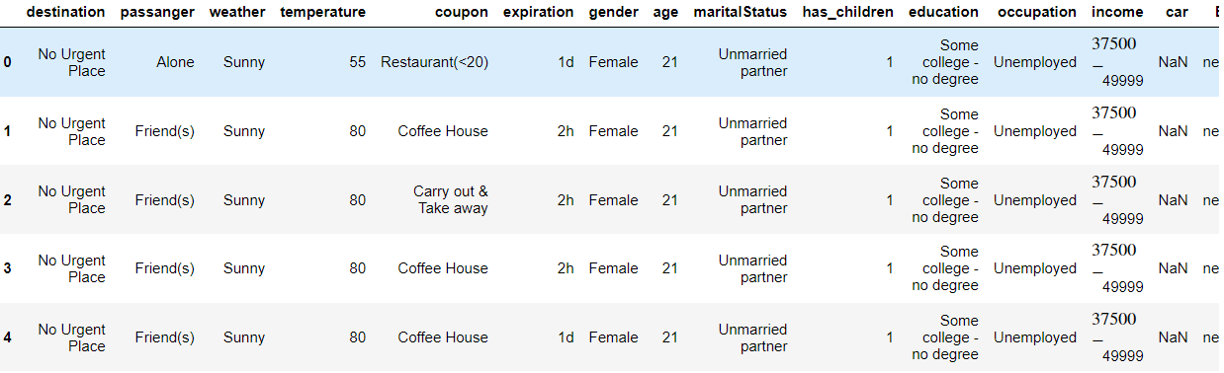
Exploratory Data Analysis
EXPLORATORY DATA ANALYSIS
Let’s have a look at the data:
This dataset has 12684 data points and 25 features along with their target label. The first 5 rows appeared as shown above.

Slide 7
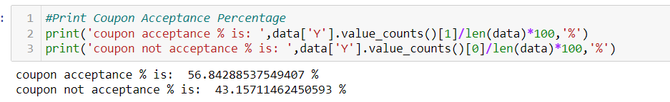
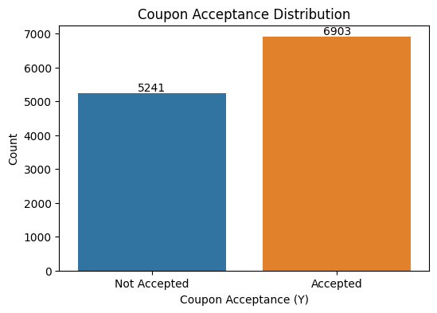
Exploratory Data Analysis
EXPLORATORY DATA ANALYSIS
Distribution of classes
The output indicates that approximately 6903 of the records correspond to coupon acceptance, while about 5241 correspond to coupon non-acceptance in the dataset and coupon acceptance rate is higher than coupon not acceptance rate.

Slide 8
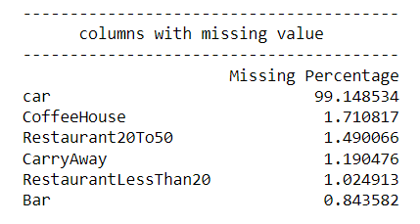
Exploratory Data Analysis
EXPLORATORY DATA ANALYSIS
Missing values
Luckily, we don’t have a lot of missing values except of few columns. Car attribute has more than 99% of missing values so we will simply drop it as imputing at so many places could risk changing the distribution of data.
As bar column has less than 1 % of missing value, we can impute mode value in place of missing values.
As the missing values for the remaining columns account for approximately 1-2% of the dataset, we can consider dropping these rows. Removing these data points is unlikely to significantly impact the overall dataset.

Slide 9
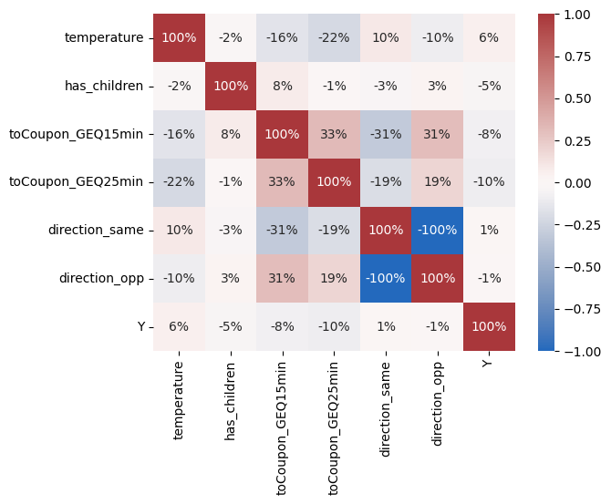
Exploratory Data Analysis
EXPLORATORY DATA ANALYSIS
Correlation of numeric features
from the above Correlation Heatmap we can see that direction_same and direction_opp are highly negatively correlated to each other. Hence we can drop one of this features. Here we are dropping direction_opp .

Slide 10
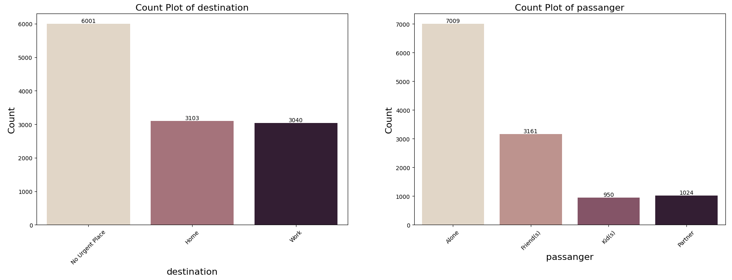
Exploratory Data Analysis
EXPLORATORY DATA ANALYSIS
destination: Most of the drivers are driving to a non urgent place and there are almost equal number of drivers driving to the "Home" and "Work“
passanger: Almost 90% of the passangers are travelling alone

Slide 11
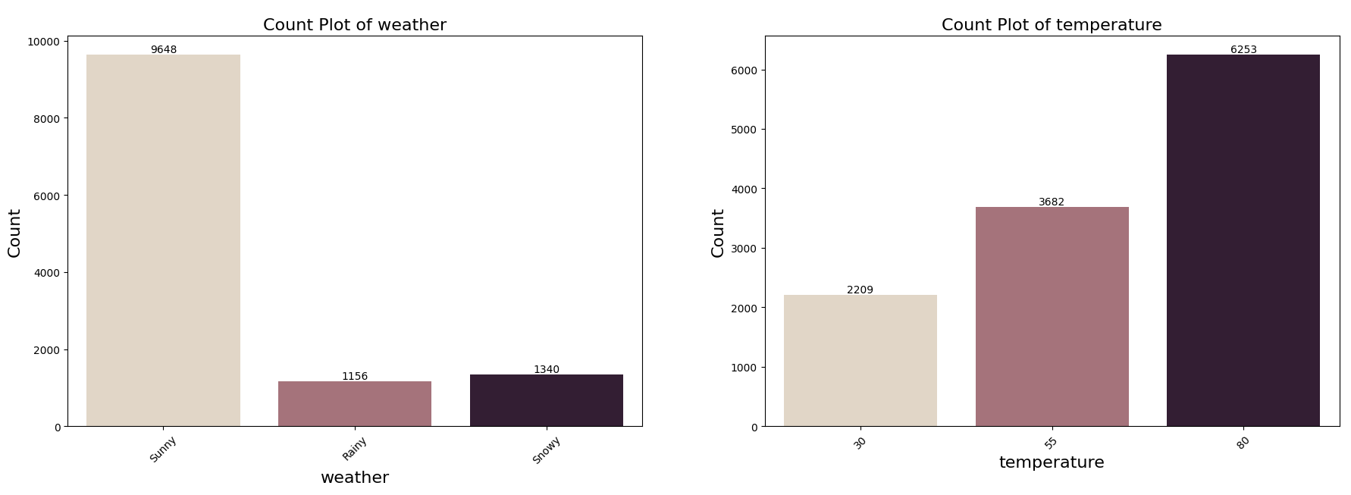
Exploratory Data Analysis
EXPLORATORY DATA ANALYSIS
The highest number of observations are obtained when the weather was sunny and Temperature is 80F.

Slide 12
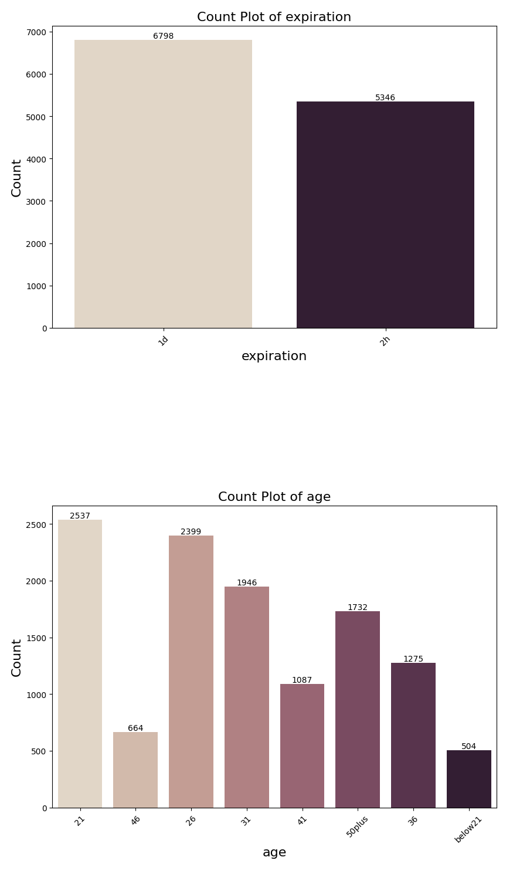
Exploratory Data Analysis
EXPLORATORY DATA ANALYSIS
Expiration: The coupons that expire in one day has larger occurance
than the coupons expiring in two hour.
Age: The drivers of the age of 21 and 26 shows the highest occurrence.

Slide 13
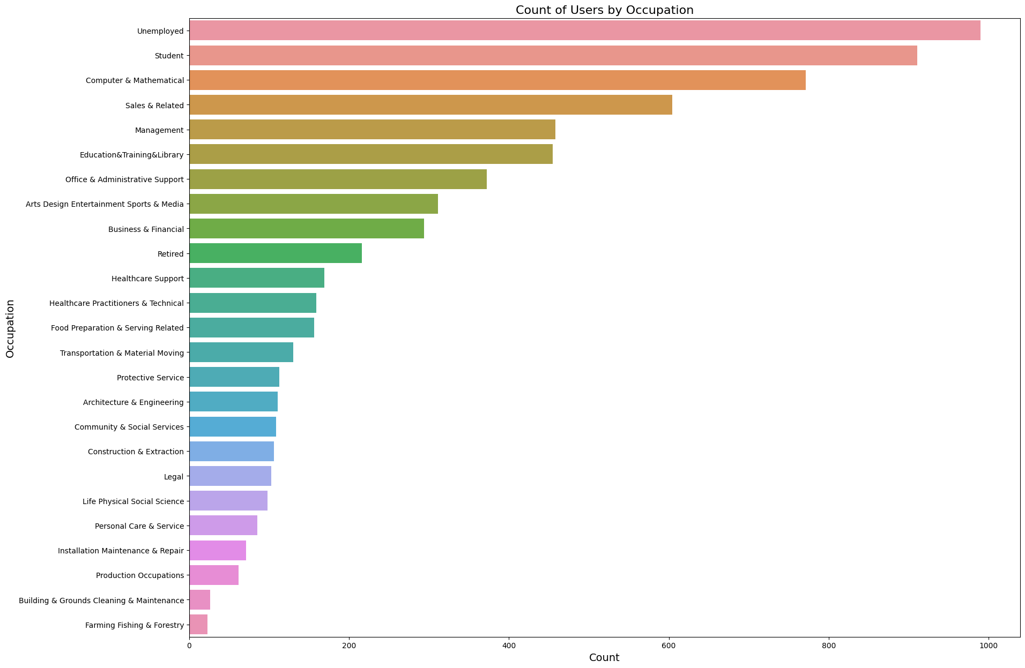
EXPLORATORY DATA ANALYSIS
The "occupation" column has many levels.From the above chart we can see that most of the drivers are unemployed & students.

Slide 14
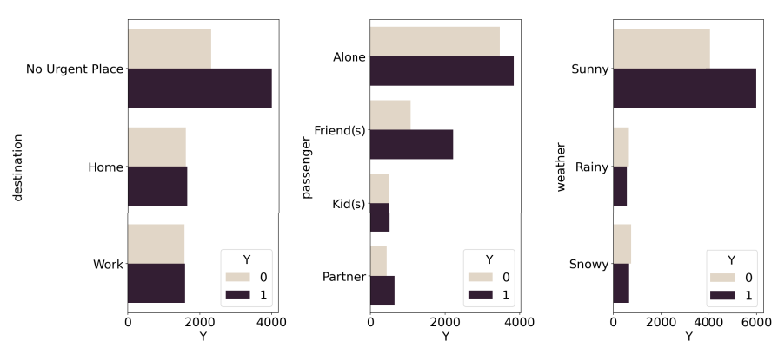
EXPLORATORY DATA ANALYSIS
Distribution of feature with respect to coupon acceptance
destination: People that has no urgent place to go has a higher probability to accept the coupon.
passenger: If the passengers in car are friends of the driver, they are more likely to accept the coupon.
weather: People tend to accept the coupon when it is sunny.

Slide 15
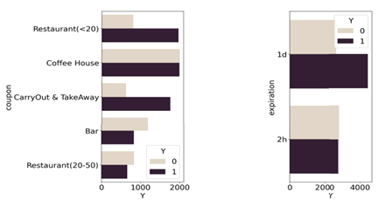
Exploratory Data Analysis
EXPLORATORY DATA ANALYSIS
Distribution of feature with respect to coupon acceptance
coupon: If the coupon is of a coffee house, the probability of accepting the coupon is just the same as rejecting it. If the coupon is of a cheap restaurant or carry out, most people will accept the coupon.
expiration: People are more likely to accept a coupon that expires in one day than 2 hr.

Slide 16
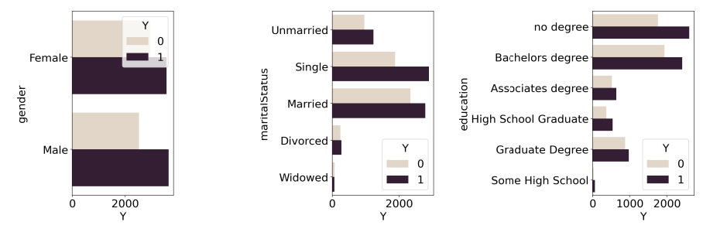
Exploratory Data Analysis
EXPLORATORY DATA ANALYSIS
Distribution of feature with respect to coupon acceptance
gender: There is no much difference between gender.
Marital Status: Single and married people are most likely to accept the coupon.
education: Some college, Bachelor degree users are more likely to accept the coupon,

Slide 17
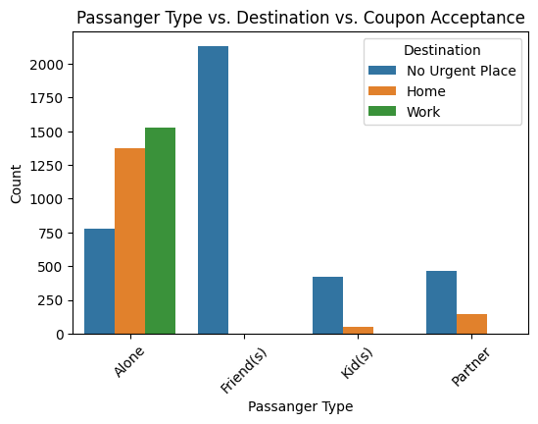
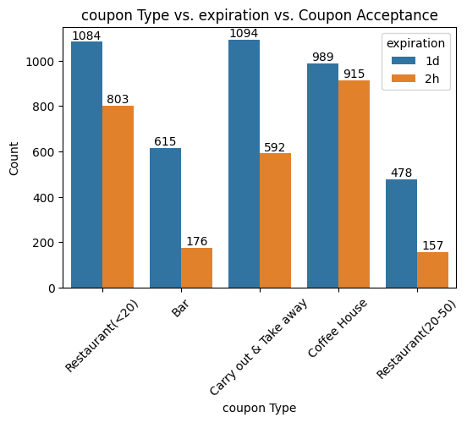
Exploratory Data Analysis
EXPLORATORY DATA ANALYSIS
The users who go with Friends have only No Urgent Place destination.
Most Users prefer to accept 1d expiration coupons than 2h expiration coupons.
Also, Users mostly accept the 1d expiration of Restaurant(<20), Carry out & Take away, and coffee house coupons.

Slide 18
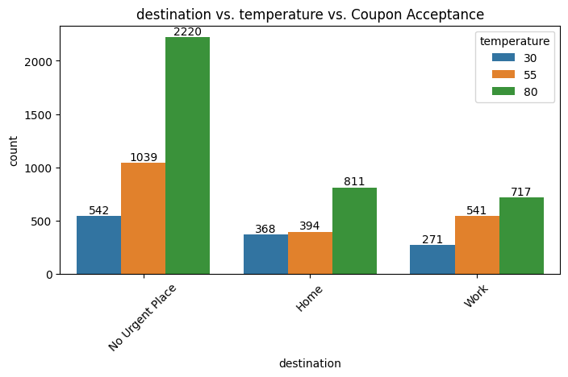
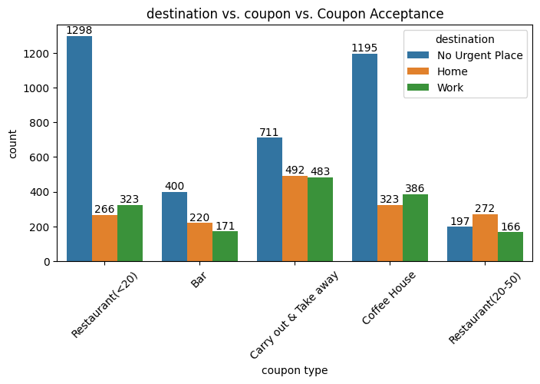
Exploratory Data Analysis
EXPLORATORY DATA ANALYSIS
Users with the destination "No Urgent Place" in 80F temperature show a higher coupon acceptance rate across all destination categories.
Users with the destination "No Urgent Place" tend to have higher coupon acceptance counts across various coupon types for "Restaurant(<20)" and "Coffee House" coupons. Among the coupon types coupon of "Restaurant(<20)" and "Coffee House" are more commonly accepted across all destinations.

Slide 19
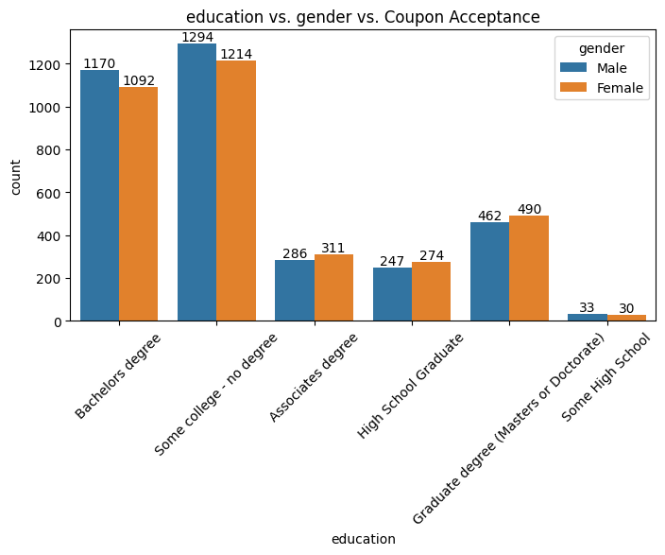
Exploratory Data Analysis
EXPLORATORY DATA ANALYSIS
From the chart we can see that,male users with "some college-no degree" education level followed by female users with same education level are mostly accepting the coupons.

Slide 20
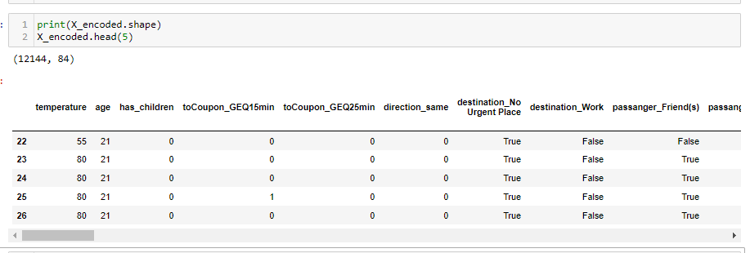
DATA PREPROCESSING
Data Encoding
We will use One-hot encoding.
Data Splitting:
Splitting data into train and test sets.
Data Scaling
After splitting the dataset into train and test performed Data normalization or scaling to Standardize numeric features.

Slide 21
Model Selection
MODEL SELECTION
We are now ready to apply machine learning algorithms to our prepared data matrices.
Here we are using the following models on our dataset.
CatBoost Classifier
Gradient Boosting
Logistic Regression
Random Forest Classifier
SVM
XGboost

Slide 22
MODEL TRAINING
Now we will plot the table comparing accuracy of each model. .
Plotting accuracy ,F1 score,AUC Table for models .
After experimenting with different models we can see that XG Boost,Gradient Boost,Cat Boost algorithms gives best results. So we performed hyper parameter tuning on these 3 models.
Comparison of the models
MODEL | ACCURACY | F1-SCORE | AUC
RANDOM FOREST | 0.74 | 078 | 0.80
LOGISTIC REGRESSION | 0.69 | 0.73 | 0.73
XG BOOST | 0.76 | 0.79 | 0.83
SVM | 0.64 | 0.74 | 0.73
GRADIENT BOOSTING | 0.76 | 0.79 | 0.82
CAT BOOST | 0.77 | 0.80 | 0.83
After applying hyperparameter tuning, test accuracy increased to 77% .Hence for our final model we will go with cat boost algorithm as it gives best accuracy,F1 score and AUC as compared to other algorithms.

Slide 23
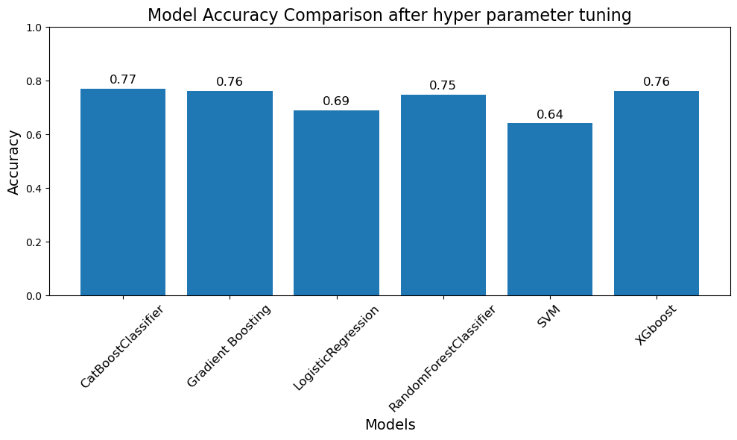
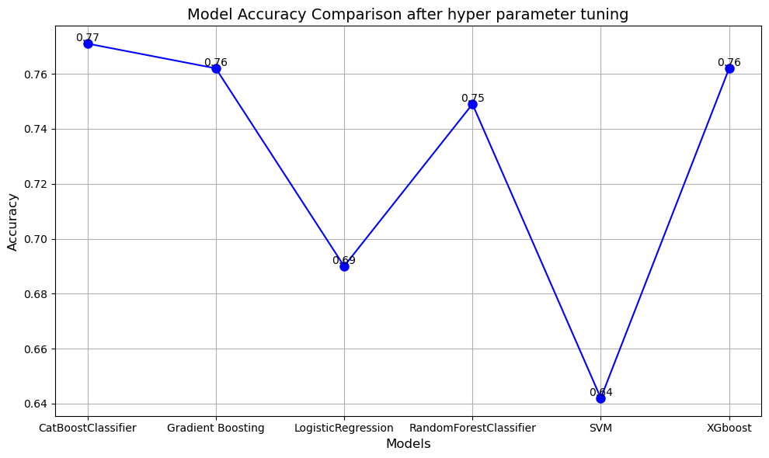
Model Accuracy Comparison

Slide 24
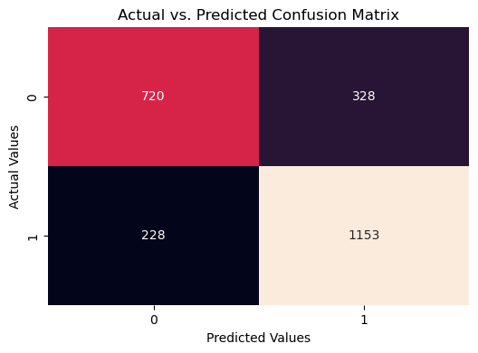
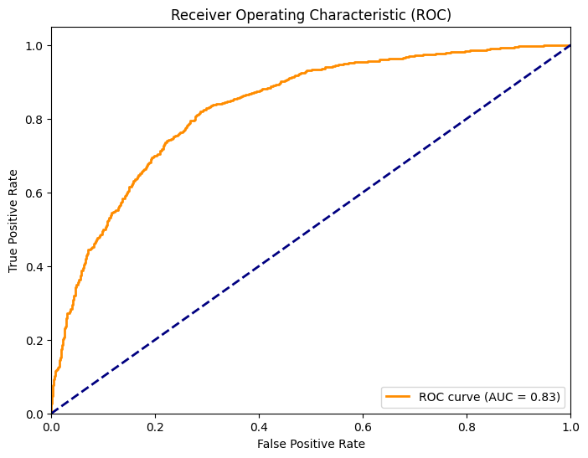
MODEL EVALUATION
ROC Curve (AUC = 0.83): The Receiver Operating Characteristic (ROC) curve illustrates the trade-off between the true positive rate (sensitivity) and false positive rate (1-specificity) across different thresholds. With an Area Under the Curve (AUC) of 0.83, our model demonstrates reasonably good discriminative power.
Confusion Matrix:
The confusion matrix provides an insight into our model's ability to correctly classify positive and negative instances.

Slide 25
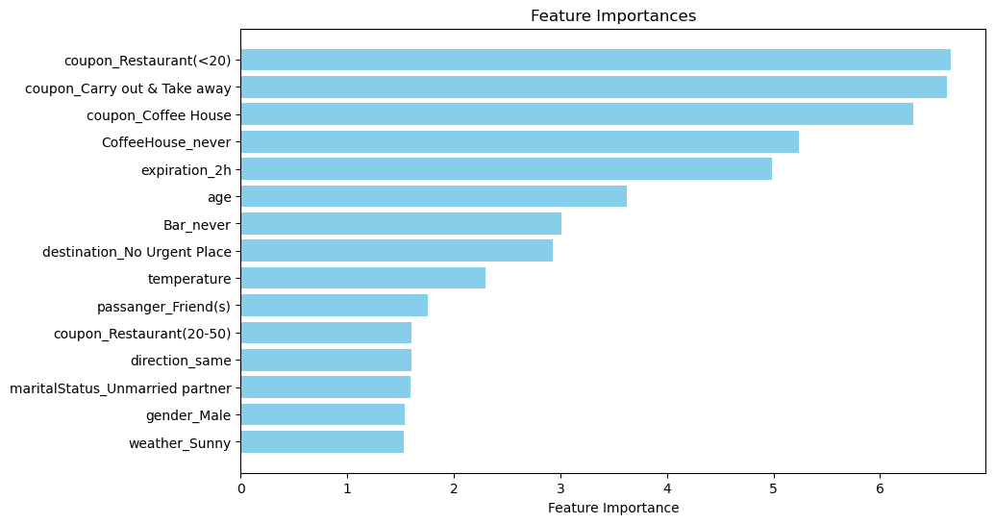
FEATURE IMPORTANCE
Based on the summary plot, it shows that coupon_Restaurant(<20) ,coupon_Carry out & Take away and coupon_Coffee House give the most impact on the model decision.

Slide 26
CONCLUSION
CONCLUSION
Model Performance: We explored various machine learning algorithms, including Gradient Boosting, XGBoost, Random Forest, SVM, Logistic Regression, and ultimately CatBoost. Among these, CatBoost yielded the highest accuracy of 77% on our dataset.
Algorithm Selection: After rigorous testing, we found that CatBoost, with its robust handling of categorical features and inherent optimization, outperformed other algorithms in our specific context.
Data Preprocessing: We employed one-hot encoding to transform categorical variables, making them compatible with our machine learning models. This preprocessing step enabled us to extract valuable insights from our data.
Model Evaluation: We employed two key evaluation metrics: the Confusion Matrix and the ROC Curve. The Confusion Matrix revealed our model's ability to classify true positives, true negatives, false positives, and false negatives. The ROC Curve, with an AUC of 0.83, demonstrated our model's discrimination capability.
Continual Improvement: While achieving a 77% accuracy is promising, there's room for improvement. We can further fine-tune hyperparameters, explore feature engineering techniques, or consider ensemble methods to enhance model performance.
Real-World Applicability: It's important to note that the success of our model in a real-world context extends beyond accuracy. Factors such as interpretability, scalability, and deployment feasibility should also be considered to ensure practical usability.

Slide 27
THANK YOU

